Slide 1
5 The Project Idea with Demonstrations
Ferhat Erata (UNIT, ModelWriter Project Leader)
Dr. Mariem Mahfoudh (CNRS/LORIA)

Slide 2
What is the problem?

Slide 3
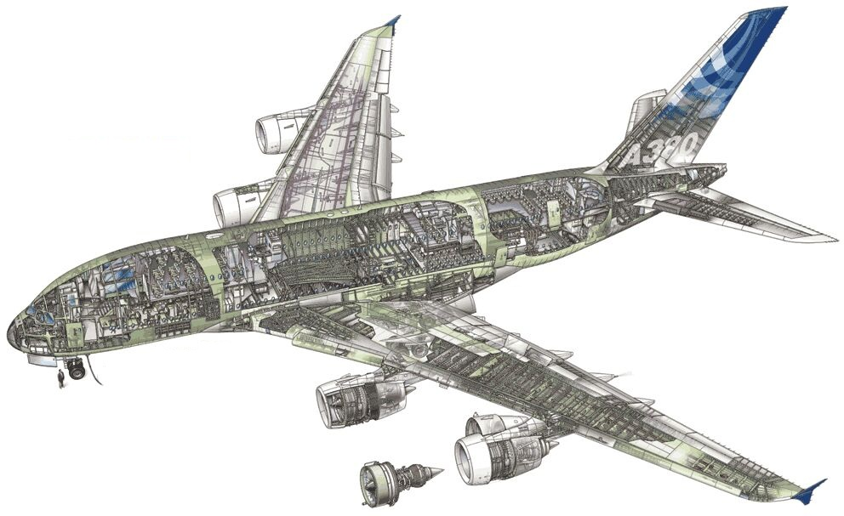
Airbus A380!
Imagine the documentation related to design principles.

Slide 4
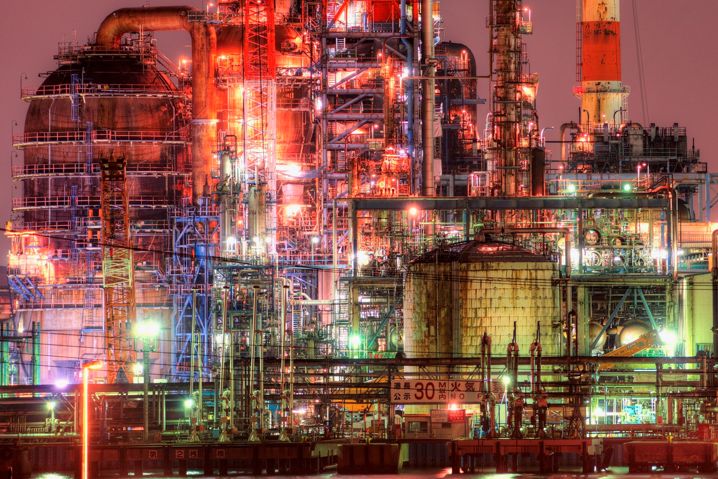
Plants!
Imagine the documentation of a construction site.

Slide 5
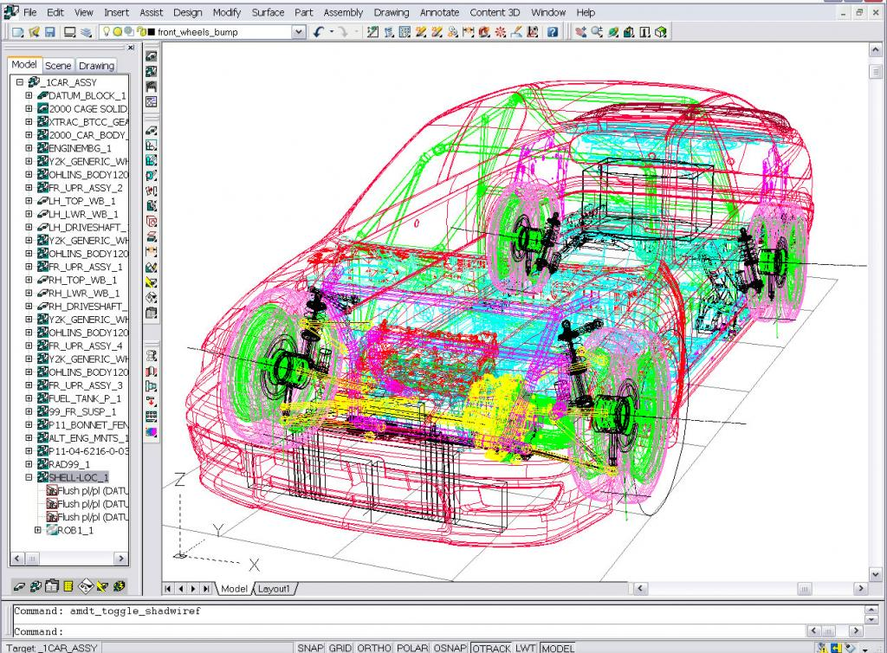
Automobiles!
Imagine the technical specifications

Slide 6
Documentation!
Write once … and never look at after

Slide 7
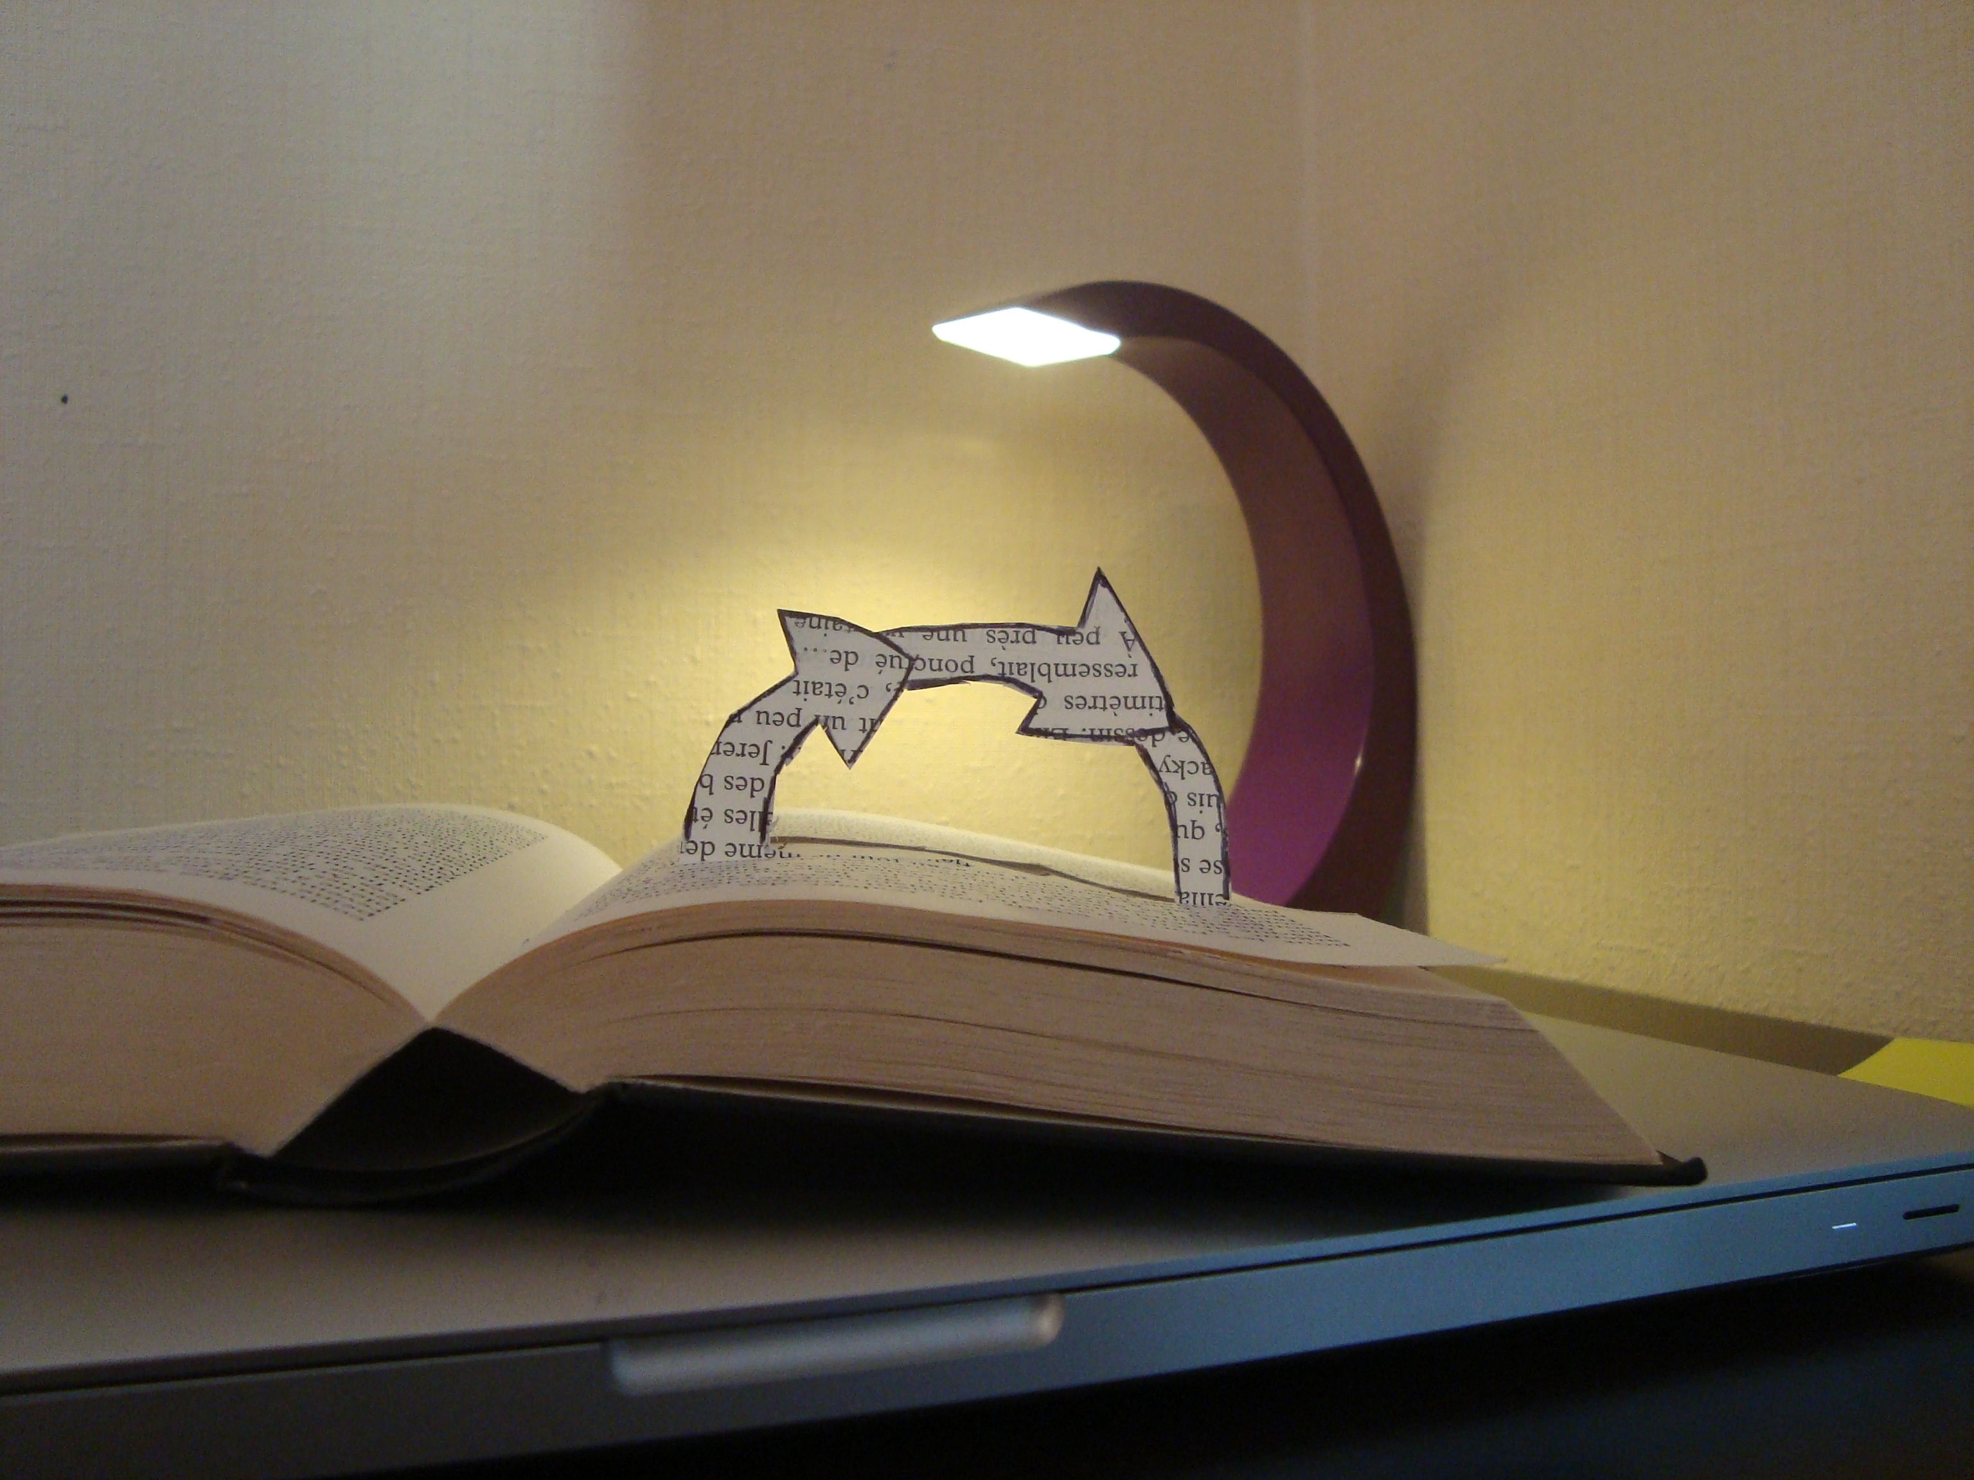
Documentation!
Hard to keep it up-to-date

Slide 8

Documentation!
Useful for users / Boring to write

Slide 9

Semantics!
No meaning of syntax (words, sentences …)

Slide 10
What is a text?

Slide 11
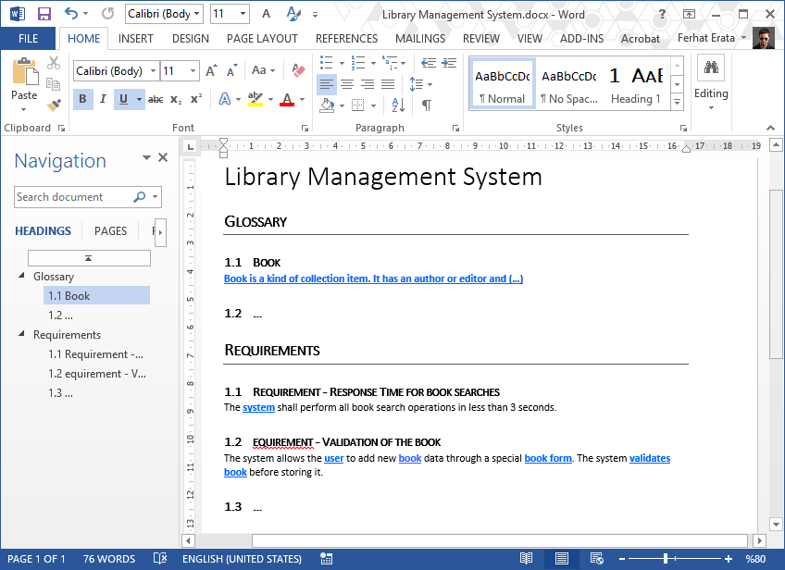
What is a text? (document file formats) Office Open XML (.docx) (ISO/IEC 29500)

Slide 12
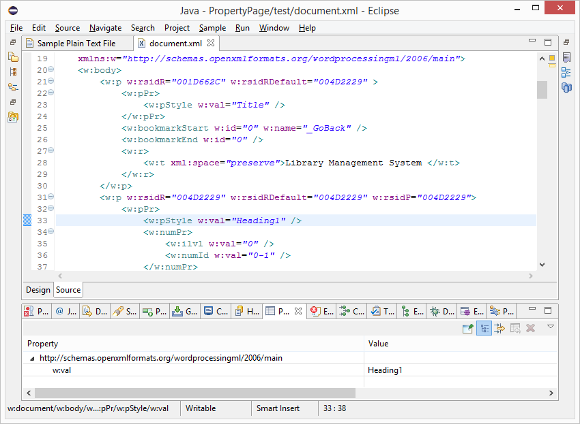
What is a text? (document file formats) Office Open XML (.docx) (ISO/IEC 29500)

Slide 13
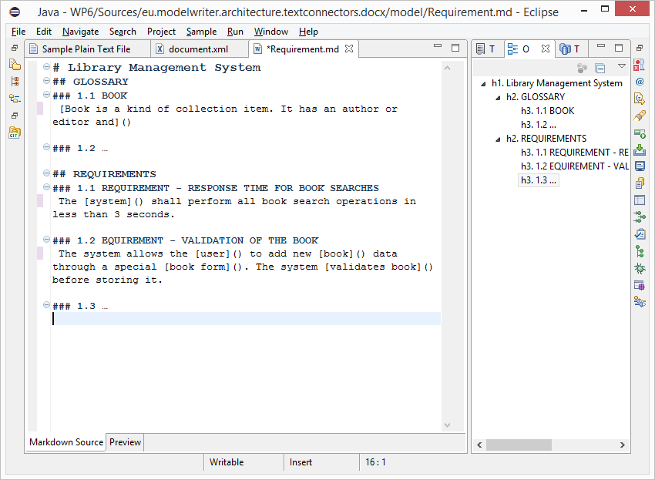
What is a text? (.md source file) text/markdown (ICANN Standard)

Slide 14
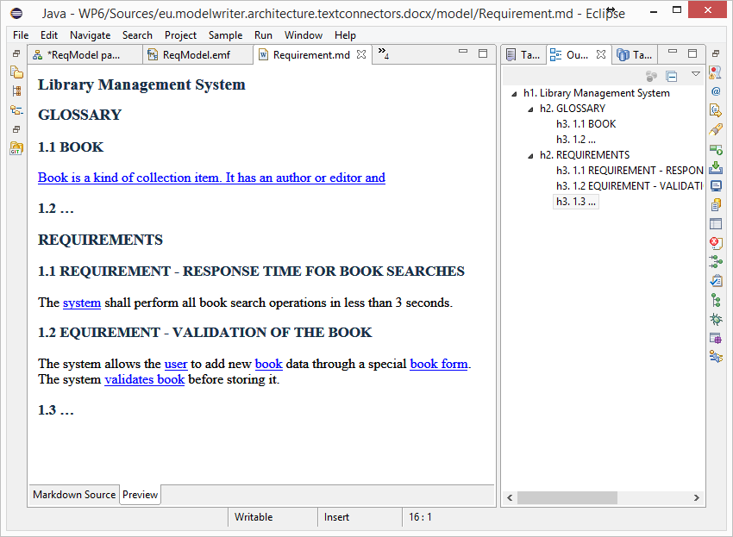
What is a text? (HTML Preview) text/markdown (ICANN Standard)

Slide 15
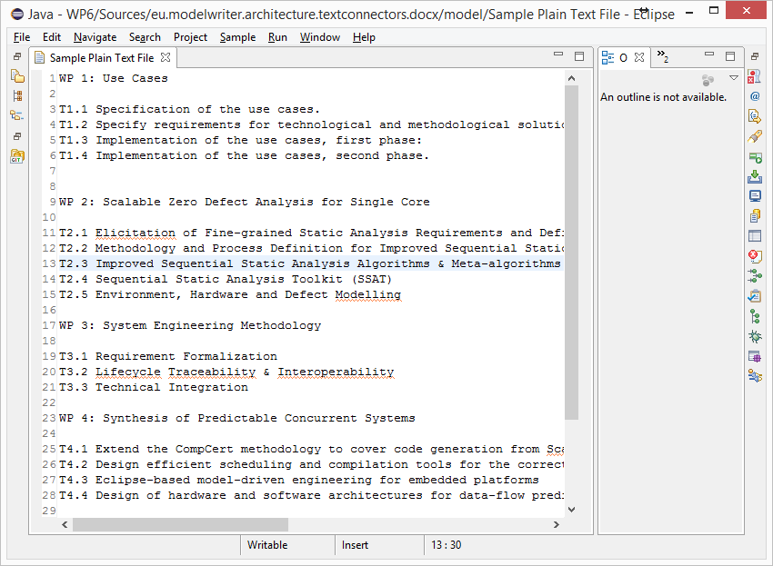
What is a text? (unformatted text) text/plain (ICANN Standard)

Slide 16
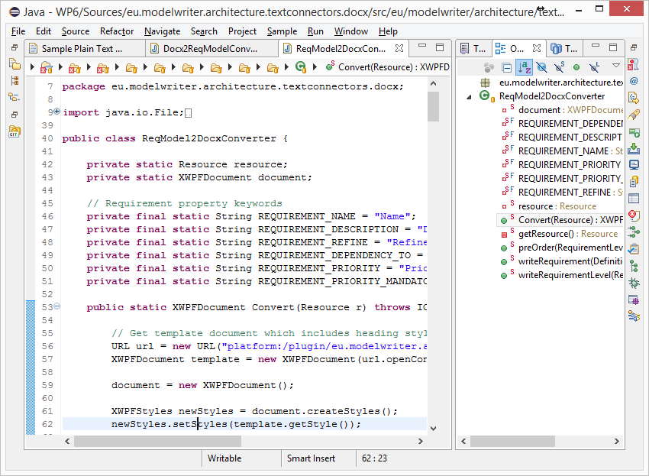
What is a text? (code files) Java, C++ … Programing Languages

Slide 17
What is a model?

Slide 18
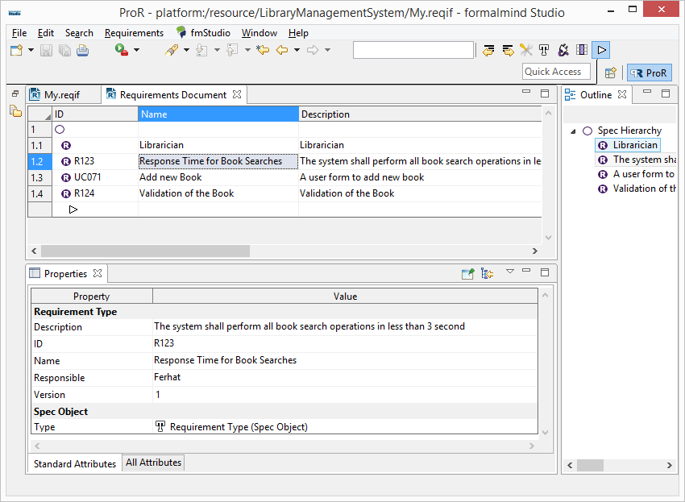
Everything is a model! (ReqIF Standard) Requirements Interchange Format

Slide 19
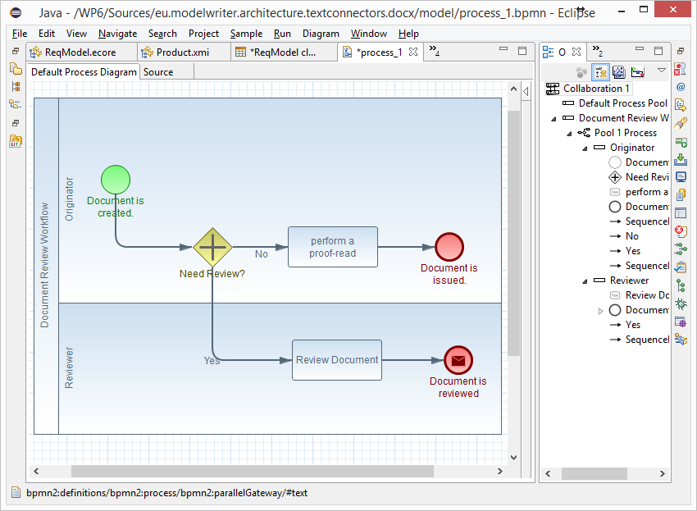
Everything is a model! (BPMN Standard) Business Process Model & Notation

Slide 20
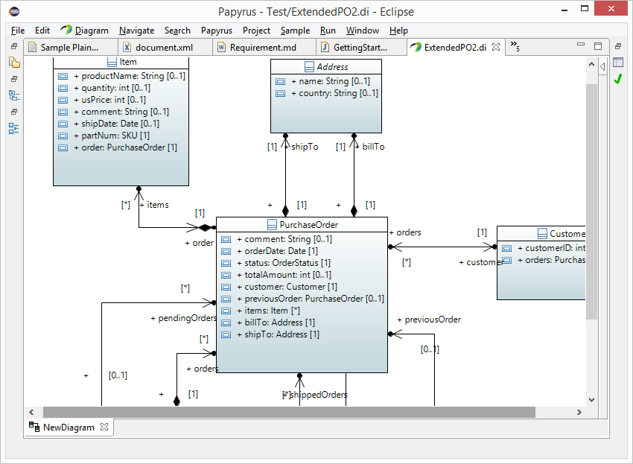
Everything is a model! (UML Standard) UML Modeling Languages

Slide 21
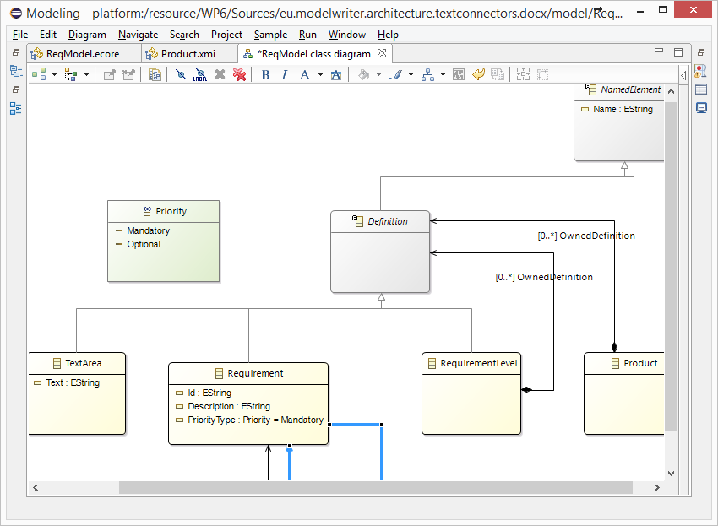
Everything is a model! Eclipse Modeling Framework (EMF)

Slide 22
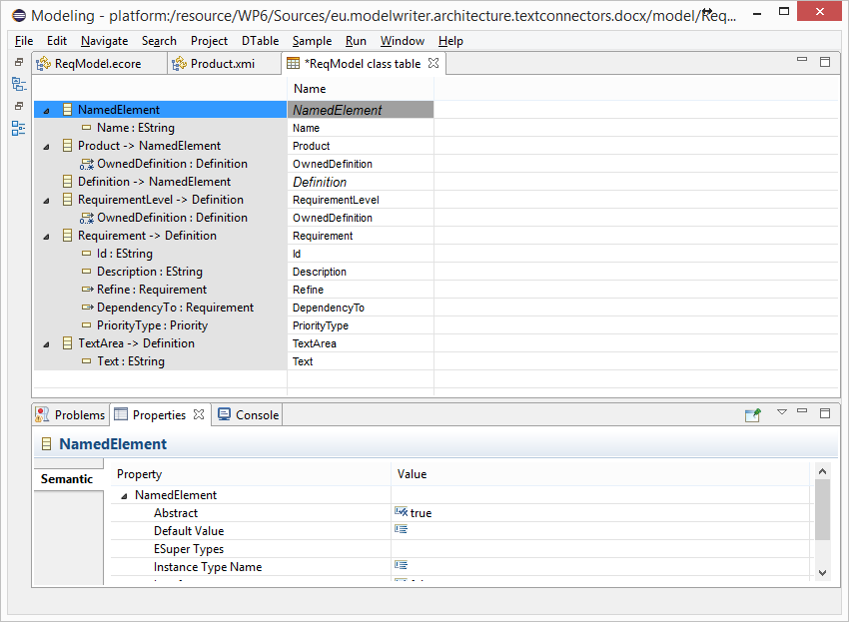
Everything is a model! Tree-based or Tabular Representations

Slide 23
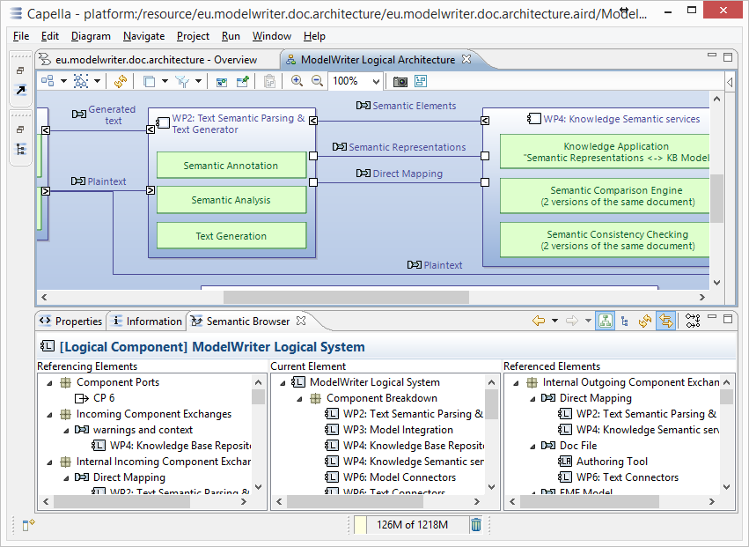
Everything is a model! Software/System Architecture Design

Slide 24
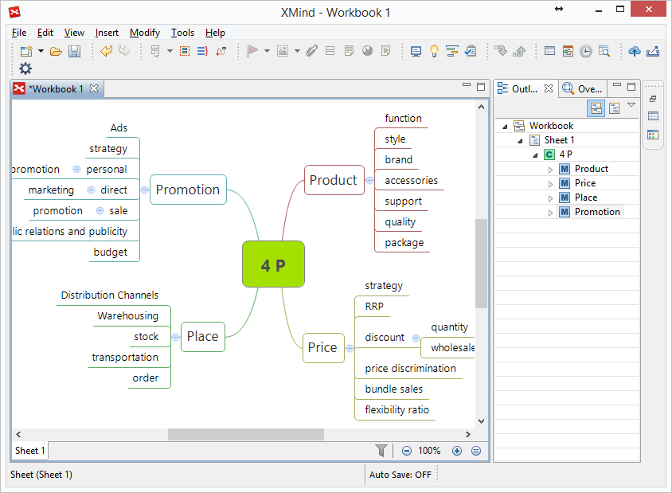
Everything is a model! Topic Maps, Mind Maps, Vocabularies …

Slide 25
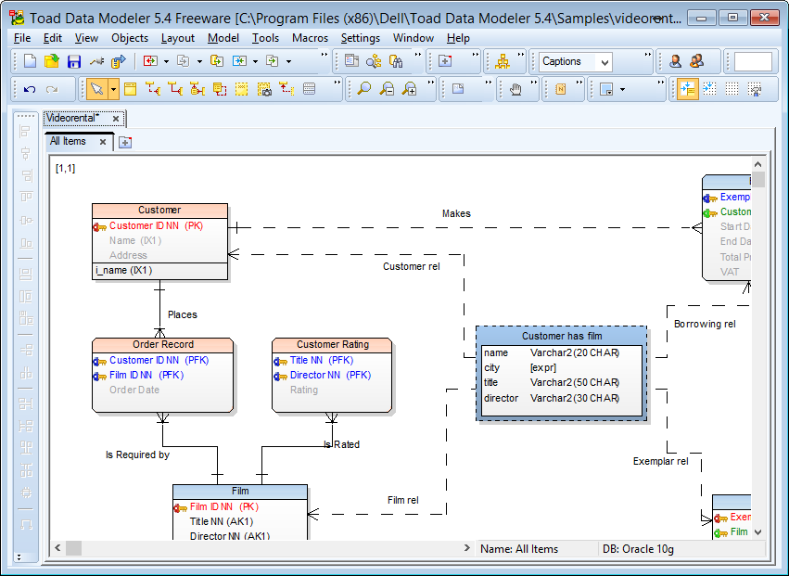
Everything is a model! Databases (ER, IDEF1.x)

Slide 26
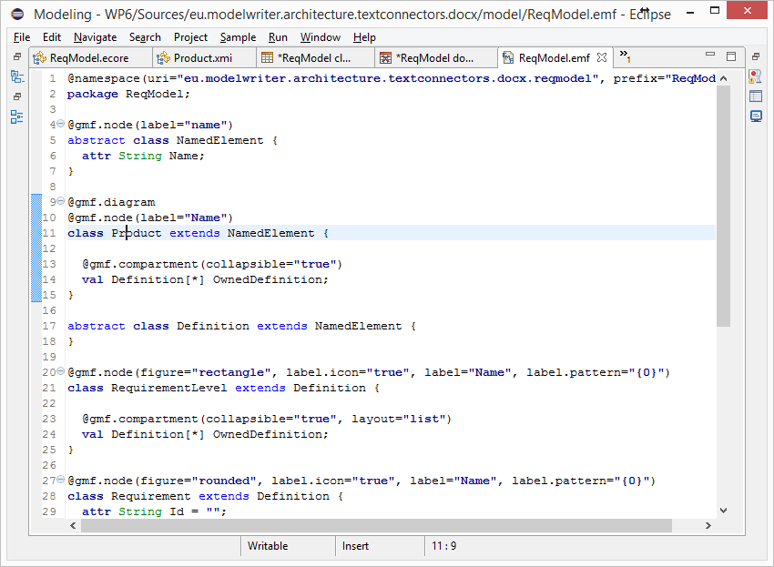
Everything is a model! (Textual Lang.) Domain Specific Languages

Slide 27
Everything is a model! (Java, C++, etc.) Even Programing Languages (ASTs)

Slide 28
Is it possible to connect and keep arbitrary software/system engineering artifacts synchronized ?

Slide 29
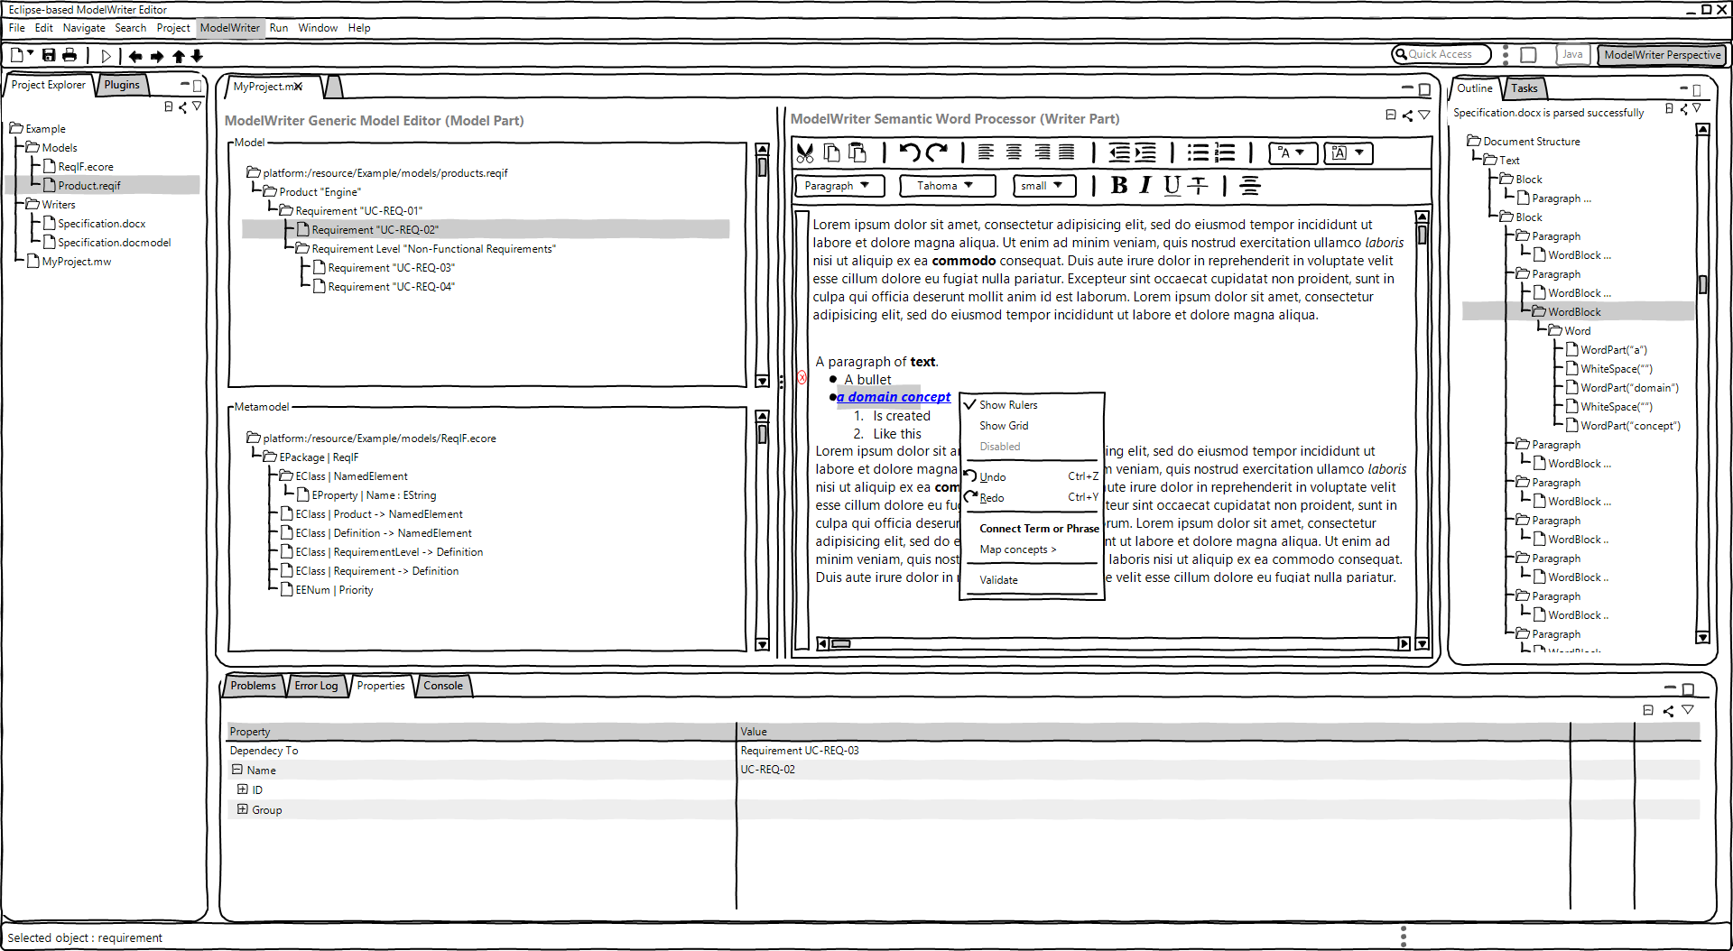
ModelWriter – The Solution
Text & Model-Synchronized Document Engineering Platform

Slide 30
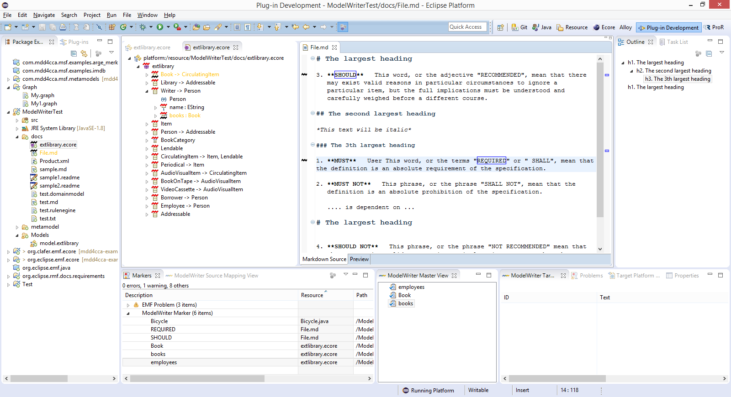
Solution – Knowledge Capture
Text & Model-Synchronized Document Engineering Platform

Slide 31
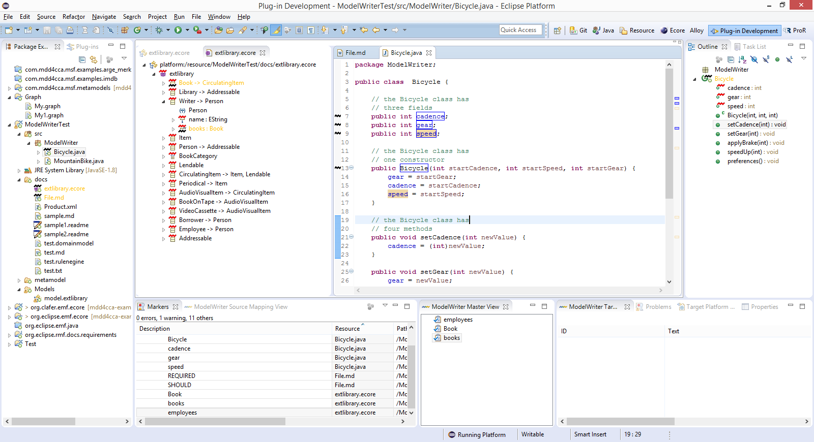
Solution – Knowledge Capture
Text & Model-Synchronized Document Engineering Platform

Slide 32
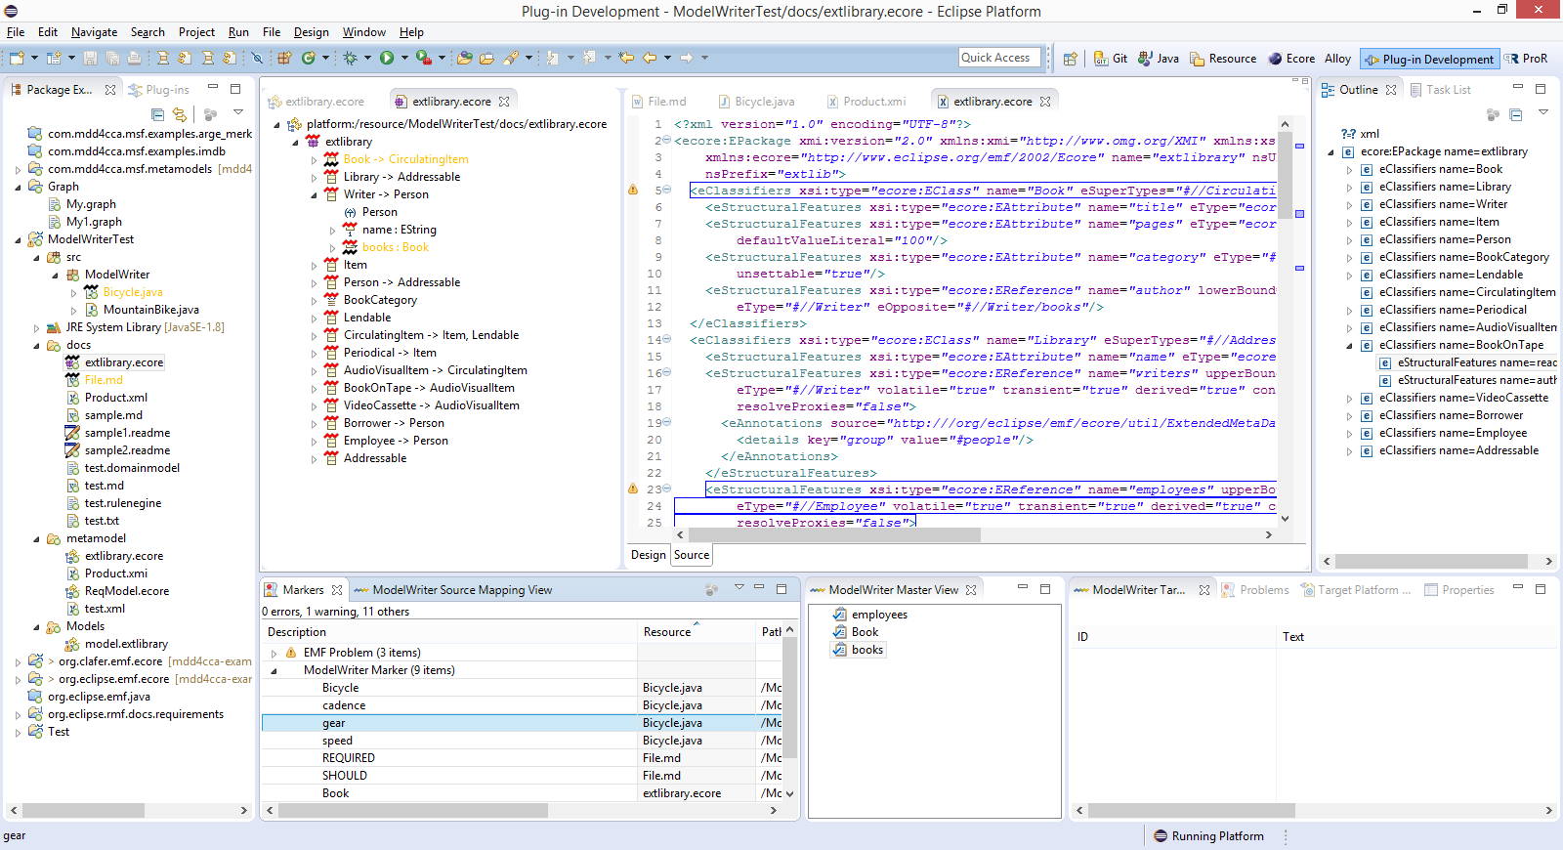
Solution – Knowledge Capture
Text & Model-Synchronized Document Engineering Platform

Slide 33
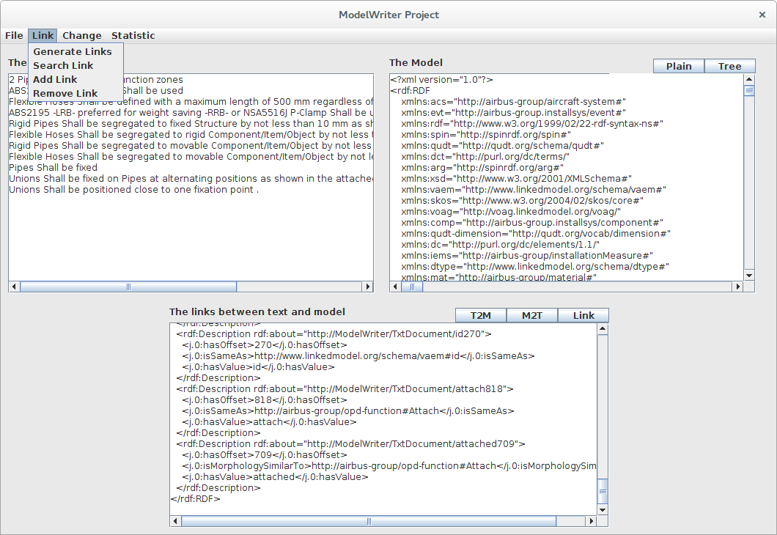
Solution – Knowledge Extraction
Text & Model-Synchronized Document Engineering Platform

Slide 34
Synchronization is maintained!

Slide 35
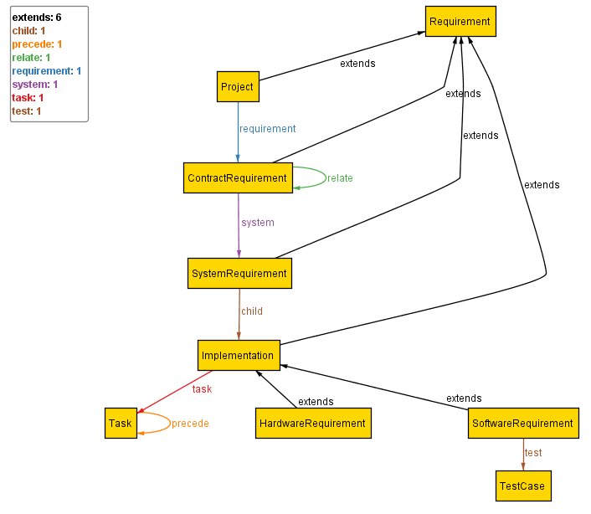
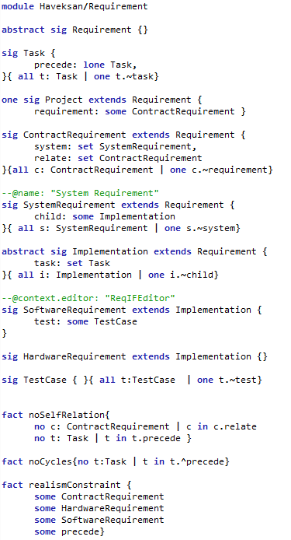
Configuration:HAVELSAN example
A Formal Specification Model to configure the ModelWriter

Slide 36
ModelWriter Quantification of the expected benefits
Improvement in quality and productivity of technical documentation.
Quality increase of the product with consistent requirements and designs.
For instance, according to AIRBUS’s claims in their use cases, the global saving would be 5 M€ to 7 M€ (A350 Recurring Cost)
50% reduction of costs for keeping the documentation up-to-date with the developed software

Slide 37
Thank you for your attention We value your opinion and questions.

